Slide 1
Maintainability- Modular Design
Bachelor of Engineering- Computer Science & Engineering
System Design(SD)(22CS024)
Department of Computer Science & Engineering
Chitkara University Institute of Engineering and Technology, Chitkara University, Punjab, India

Slide 2

Maintainability determines how easy and profitable it will be to maintain, update, and do upgrades in the software system.

Slide 3
Along with Scalability, trust ability, and Security, Maintainability is also a pivotal factor of a system software.
Further justifiable a system will be, the easier it'll be for inventors to make changes to it, and the more effective the system will be, the lower the time-out will be in case of an issue.
A largely justifiable system contains the following characteristics:
Modularity: It's organized into different factors or modules, allowing maintainers to understand and modify individual pieces without affecting the rest of the system.

Slide 4
Readability: Its Codebase is clear, terse, and readable, making it easier for maintainers or other team members to understand and modify.
Error Handling: It's designed to handle problems or issues effectively, furnishing meaningful error dispatches and avoiding disastrous failures.
Utilizes VCS: It Utilizes VCS similar to Git for effective shadowing of changes and making collaboration easier.
Testability: It's effective in testability and helps in relating implicit issues snappily.

Slide 5
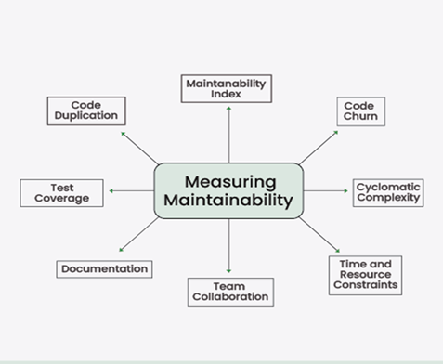
Measuring Maintainability
While measuring maintainability is subjective,
here are some metrics to measure it: -

Slide 6
Code Duplication
The percentage of duplicated code present in the system can be an indicator of maintainability. Code duplication occurs when the same or very similar code appears in multiple places within the system. In that case, changes made to one component of duplicated code may need to be applied to other areas too. Code duplication can be measured with static code analysis tools that identify duplicated code segments.
Maintainability Index
It provides an overall score that represents the maintainability of a specific component/Code module/Entire system. The formula for calculating the Maintainability Index varies depending upon the IDE you are using, it basically combines complexity, duplication, and other factors to produce a single value. Higher Maintainability Index scores indicate better maintainability and many people in tech use this metric to identify sections of the codebase that require enhancements.

Slide 7
Test Coverage
It measures the extent to which automated tests cover the codebase, It helps prevent regressions from being introduced. Test coverage tools assess the extent of code exercised by automated tests, expressed as a percentage.
Documentation
Good documentation reduces the learning curve for new Devs and helps the existing team understand it better during maintenance. A Good documentation is the one, which makes a newcomer understand the project and also covers not only code comments but also architectural decisions, System design, API references, as well.

Slide 8
Team Collaboration
A strong collaborative culture within the development team helps them share knowledge with each other, perform Knowledge Transfer programs (KT), mentor newcomers, and work together on maintenance tasks, it helps team members grow together and makes sure someone won't struggle in doing a particular task.
Time and Resource constraints
It's important to balance between speed of development as well as speed of maintainability. A rush by the development team to complete a tight deadline without considering maintainability can lead to complicated future maintenance efforts.
Code Churn
It measures the frequency of changes to a code module over time using Version Control's data. Active maintenance is essential for improvements and bug fixes, but excessive code churn may also indicate instability and the need for more thorough testing. By monitoring, focus areas of the system that may require more attention can be identified during maintenance.

Slide 9
Cyclomatic Complexity
It measures the complexity of a code module. Higher complexity is an indication that the code is more complicated to understand and there may be potential easier ways available to break the complexity of a particular code module.

Slide 10
Introduction to Modularity
In software design, modularity means breaking down big problems into smaller, more manageable parts. Interfaces are like bridges that connect these parts together.
Definition: The process of breaking down a complex system into smaller, more manageable components or modules is known as modularity in system design. Each module is designed to perform a certain task or function, and these modules work together to achieve the overall functionality of the system.

Slide 11
The key characteristics of modularity
Flexibility: Allows for easy customization and adaptation to changing requirements.
Abstraction: Modules provide clear, high-level interfaces abstracting complex functionality.
Collaboration: allows teams to operate independently on various modules, which promotes parallel development.
Testing: Modular systems are easier to test as each module can be tested separately, promoting robustness.
Documentation: Encourages better documentation practices as module interfaces need to be well-defined and documented.
Interchangeability: Modules can be swapped or upgraded without affecting the overall system functionality, promoting interoperability.

Slide 12
Below are the key components of Modular Design:
Modules: These are the smaller, separate components that comprise the system as a whole. Every module is self-contained, has clearly defined interfaces to other modules, and is made to carry out a specific task.
Interfaces: These are where modules can communicate with one another. Interfaces, which can be software, mechanical, or electrical connections, specify how the modules communicate with one another.
Subsystems: These are groups of modules that work together to perform a specific function within the overall system.
Integration: This involves integrating the various modules to form an integrated unit and testing the system as a whole to make sure everything is operating as it should.
Maintenance: To make sure the system keeps functioning properly, this involves maintaining an eye on it and updating it as necessary. In some cases, this may involve changing or swapping out certain modules.
Documentation: This includes all of the technical and operational information about the system, including schematics, manuals, and instructions for use.

Slide 13
Some of the important benefits of modularity are:
Improved flexibility: Modular designs allow individual components or modules to be easily added, removed, or replaced, making it easy to modify the product to meet changing needs or requirements.
Increased efficiency: Modular designs enable different parts of the product to be developed and tested independently, allowing for faster development and more efficient use of resources.
Improved quality: By enabling more extensive testing of individual parts and making it easier to employ better materials and building methods, modular designs can raise a product's overall quality.
Enhanced scalability: Because modules can be added or removed as needed, modular designs may ease the process of scaling a product up or down in terms of size, capacity, or capability.

Slide 14
THANK YOU

